Slide 1
DS: Graph, Priority Queue &Heap (incl. Space Complexity)​
Session 06
Nikita Ananda Putri Masaling, S.Kom., M.Kom.

Slide 2
Learning Outcomes
Session 6
At the end of this session, students will be able to:​
LO 1: Evaluate the time and space complexity of algorithms usingasymptotic notation and formal analysis methods, and prove algorithmcorrectness using loop invariants, induction, or exchange arguments.​
LO 2: Analyze unfamiliar computational problems by identifying theirstructural properties, classifying them into known algorithmic categoriesincluding graph, string, and combinatorial problems and recommending asolution strategy with justification.​

Slide 3
Outline materials
Session 6
Graph Representations: Adjacency Matrix vs. Adjacency List
Space Complexity Trade-off in Graph Representations
Priority Queue: Concept and Interface
Heap: Structure, Heapify, Insert, Extract-Max
Space Complexity Across Data Structures — Comparative Summary

Slide 4
Graph concept & application
concept
A graph is an abstract data structure that is used to implement the mathematical concept of graphs.
It is basically a collection of vertices (also called nodes) and edges that connect these vertices.
A graph is often viewed as a generalization of the tree structure, where instead of having a purely parent-to-child relationship between tree nodes, any kind of complex relationship can exist.

Slide 5


Graph concept & application
Formal definition
A graph G is defined as an ordered set (V, E), where:
  V(G) represents the set of vertices and;
  E(G) represents the edges that connect these vertices.
A graph can be directed or undirected:
  In an undirected graph, edges do not have any direction associated with them.
  In a directed graph, edges form an ordered pair.
Above Graph have V(G)={A, B, C, D, E} and E(G)={(A, B), (A, D), (B, C), (B, D), (C, E), (D, E)}
Above Graph have V(G)={A, B, C, D, E} and E(G)={(A, B), (A, D), (B, D), (C, B), (D, E), (E, C)}

Slide 6
Graph representation
concept
There are two most common ways of storing graphs in the computer’s memory:
  Sequential representation using adjacency matrix.
  Linked list representation using adjacency list.

Slide 7
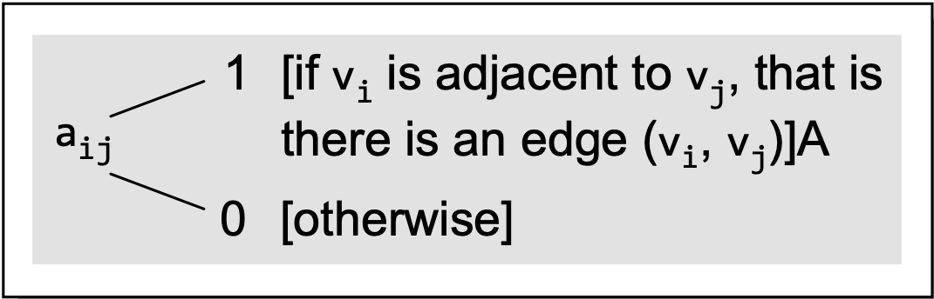
Graph representation
Adjacency matrix
An adjacency matrix is used to represent which nodes are adjacent to one another.
By definition, two nodes are said to be adjacent if there is an edge connecting them.
Here is the rules for adjacency matrix for each entry:

Slide 8
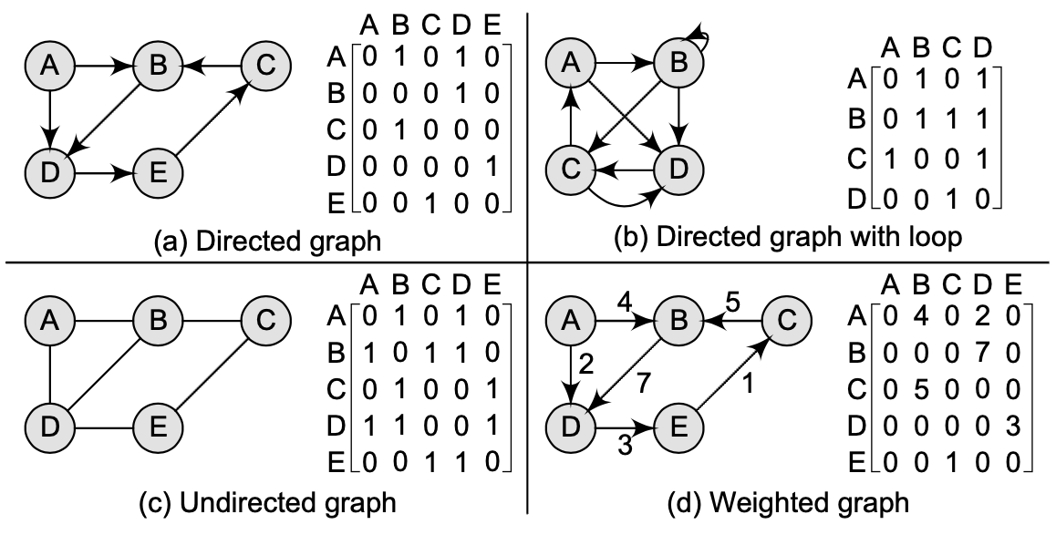
Graph representation
Adjacency matrix
Here is the example of adjacency matrix for various type of graphs:

Slide 9
Graph representation
Adjacency matrix
From the examples, we can draw the following conclusions:
  For a simple graph (that has no loops), the adjacency matrix has 0s on the diagonal.
  The adjacency matrix of an undirected graph is symmetric.
  Number of 1s (or non-zero entries) in an adjacency matrix is equal to the number of edges in the graph.
  The adjacency matrix for a weighted graph contains the weights of the edges connecting the nodes.

Slide 10
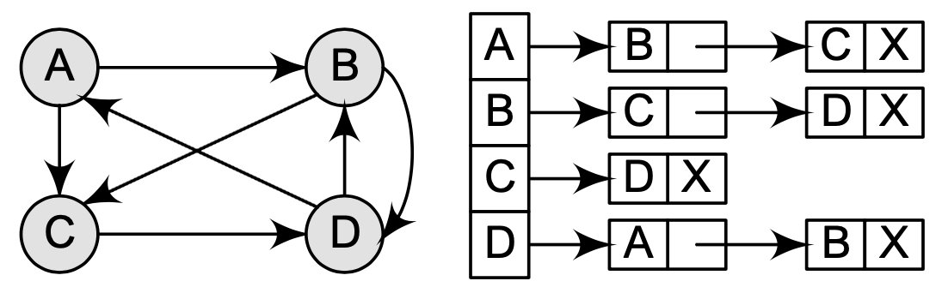
Graph representation
Adjacency list
This structure consists of a list of all nodes in G.
Furthermore, every node is in turn linked to its own list that contains the names of all other nodes that are adjacent to it.

Slide 11
Graph representation
Adjacency list
The key advantages of using an adjacency list are:
  It is easy to follow and clearly shows the adjacent nodes of a particular node.
  It is often used for storing graphs that have a small-to-moderate number of edges.
  Adjacency list is preferred for representing sparse graphs in the computer’s memory; otherwise, an adjacency matrix is a good choice.
  Adding new nodes in G is easy and straightforward when G is represented using an adjacency list. Adding new nodes in an adjacency matrix is a difficult task, as the size of the matrix needs to be changed and existing nodes may have to be reordered.

Slide 12
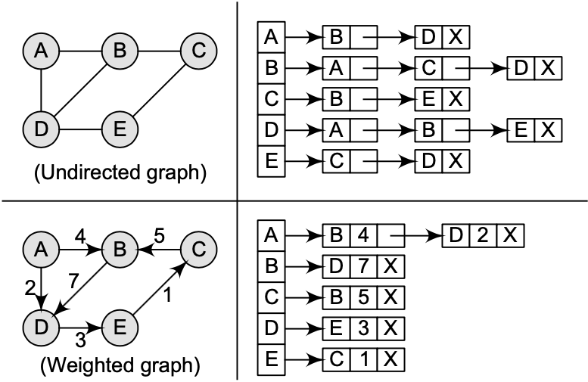
Graph representation
Adjacency list
Here is example of adjacency list with undirected graph:

Slide 13
Graph representation
Adjacency list
Here is example of adjacency list with weighted directed graph:

Slide 14

Graph analysis
Complexity analysis
Space Complexity:
  Adjacency List: $O(V+E)$
  Adjacency Matrix: $O(V^{2})$

Slide 15
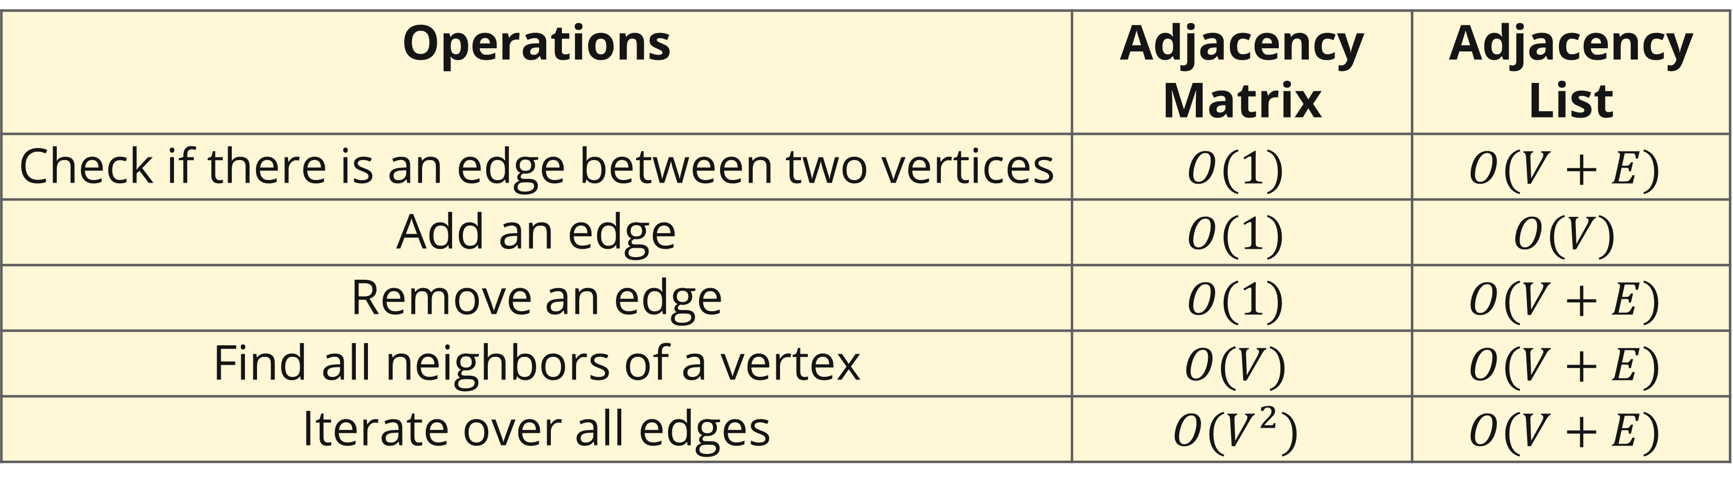
Graph analysis
Complexity analysis
Worst-case time complexity of operations in a Graph:
Discuss the explanation with your friends and confirm to your lecturer.
Operations | Adjacency Matrix | Adjacency List
Check if there is an edge between two vertices | $$O(1)$$ | $$O(V+E)$$
Add an edge | $$O(1)$$ | $$O(V)$$
Remove an edge | $$O(1)$$ | $$O(V+E)$$
Find all neighbors of a vertex | $$O(V)$$ | $$O(V+E)$$
Iterate over all edges | $$O(V^{2})$$ | $$O(V+E)$$

Slide 16
Graph Representations
Space comparison
For a sparse graph (E = O(V)), adjacency list uses O(V) space vs. O(V²) for the matrix — a factor-of-V improvement.
Representation | Space | Edge check | Iterate neighbors
Adjacency matrix | O(V²) | O(1) | O(V)
Adjacency list | O(V + E) | O(deg(u)) | O(deg(u))

Slide 17
Graph traversal
concept
By traversing a graph, we mean the method of examining the nodes and edges of the graph.
There are two standard methods of graph traversal which we will discuss in this section:
  Breadth-first Search: Use queue as auxiliary data structure
  Depth-first Search: Use stack as auxiliary data structure
Both these algorithms make use of variable status.

Slide 18
Graph traversal
concept
Every node in the graph will have the variable status, depending its current state:
Status | State of the node | Description
1 | Ready | The initial state of node
2 | Waiting | Node N is placed on the queue or stack
3 | Processed | Node N has been processed

Slide 19
Graph traversal
Breadth-first search
Breadth-first search (BFS) is a graph search algorithm that begins at the root node and explores all the neighboring nodes.
Then for each of those nearest nodes, the algorithm explores their unexplored neighbor nodes, and so on, until it finds the goal.

Slide 20
Graph traversal
Breadth-first search: algorithm
Step 1: SET STATUS = 1 (ready state) for each node in G
Step 2: Enqueue the starting node A and set its STATUS = 2 (waiting state)
Step 3: Repeat Steps 4 and 5 until QUEUE is empty
Step 4: Dequeue a node N. Process it and set its STATUS = 3 (processed state).
Step 5: Enqueue all the neighbours of N that are in the ready state (whose STATUS = 1) and set their STATUS = 2 (waiting state) [END OF LOOP]
Step 6: EXIT

Slide 21
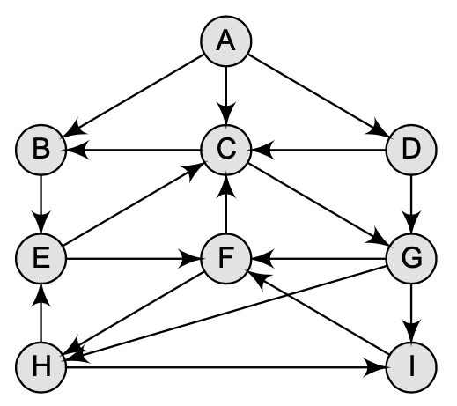
Graph traversal
Breadth-first search: example
Let’s consider this graph to use BFS.

Slide 22
Graph traversal
Breadth-first search: example
Node | State
A | 1
B | 1
C | 1
D | 1
E | 1
F | 1
G | 1
H | 1
I | 1
Queue
Processed

Slide 23
Graph traversal
Breadth-first search: example
Node | State
A | 2
B | 1
C | 1
D | 1
E | 1
F | 1
G | 1
H | 1
I | 1
Queue
A
Processed

Slide 24
Graph traversal
Breadth-first search: example
Node | State
A | 3
B | 2
C | 2
D | 2
E | 1
F | 1
G | 1
H | 1
I | 1
Queue
B
C
D
Processed
A

Slide 25
Graph traversal
Breadth-first search: example
Node | State
A | 3
B | 3
C | 2
D | 2
E | 2
F | 1
G | 1
H | 1
I | 1
Queue
C
D
E
Processed
A
B

Slide 26
Graph traversal
Breadth-first search: example
Node | State
A | 3
B | 3
C | 3
D | 2
E | 2
F | 1
G | 2
H | 1
I | 1
Queue
D
E
G
Processed
A
B
C

Slide 27
Graph traversal
Breadth-first search: example
Node | State
A | 3
B | 3
C | 3
D | 3
E | 2
F | 1
G | 2
H | 1
I | 1
Queue
E
G
Processed
A
B
C
D

Slide 28
Graph traversal
Breadth-first search: example
Node | State
A | 3
B | 3
C | 3
D | 3
E | 3
F | 2
G | 2
H | 1
I | 1
Queue
G
F
Processed
A
B
C
D
E

Slide 29
Graph traversal
Breadth-first search: example
Node | State
A | 3
B | 3
C | 3
D | 3
E | 3
F | 2
G | 3
H | 2
I | 2
Queue
F
H
I
Processed
A
B
C
D
E
G

Slide 30
Graph traversal
Breadth-first search: example
Node | State
A | 3
B | 3
C | 3
D | 3
E | 3
F | 3
G | 3
H | 2
I | 2
Queue
H
I
Processed
A
B
C
D
E
G
F

Slide 31
Graph traversal
Breadth-first search: example
Node | State
A | 3
B | 3
C | 3
D | 3
E | 3
F | 3
G | 3
H | 3
I | 2
Queue
I
Processed
A
B
C
D
E
G
F
H

Slide 32
Graph traversal
Breadth-first search: example
Node | State
A | 3
B | 3
C | 3
D | 3
E | 3
F | 3
G | 3
H | 3
I | 3
Queue
Processed
A
B
C
D
E
G
F
H
I

Slide 33
Graph traversal
Depth-first search: algorithm
Step 1: SET STATUS = 1 (ready state) for each node in G
Step 2: Push the starting node A on the stack and set its STATUS = 2 (waiting state)
Step 3: Repeat Steps 4 and 5 until STACK is empty
Step 4: Pop the top node N. Process it and set its STATUS = 3 (processed state)
Step 5: Push on the stack all the neighbors of N that are in the ready state (whose STATUS = 1) and set their STATUS = 2 (waiting state)
  [END OF LOOP]
Step 6: EXIT

Slide 34
Graph traversal
Depth-first search: example
Let’s consider this graph to use DFS.
We will do with starting vertex H.

Slide 35
Graph traversal
Depth-first search: example
Node | State
A | 1
B | 1
C | 1
D | 1
E | 1
F | 1
G | 1
H | 1
I | 1
Stack
Processed

Slide 36
Graph traversal
Depth-first search: example
Node | State
A | 1
B | 1
C | 1
D | 1
E | 1
F | 1
G | 1
H | 2
I | 1
Stack
H
Processed

Slide 37
Graph traversal
Depth-first search: example
Node | State
A | 1
B | 1
C | 1
D | 1
E | 2
F | 1
G | 1
H | 3
I | 2
Stack
E
I
Processed
H

Slide 38
Graph traversal
Depth-first search: example
Node | State
A | 1
B | 1
C | 1
D | 1
E | 2
F | 2
G | 1
H | 3
I | 3
Stack
E
F
Processed
H
I

Slide 39
Graph traversal
Depth-first search: example
Node | State
A | 1
B | 1
C | 2
D | 1
E | 2
F | 3
G | 1
H | 3
I | 3
Stack
E
C
Processed
H
I
F

Slide 40
Graph traversal
Depth-first search: example
Node | State
A | 1
B | 2
C | 3
D | 1
E | 2
F | 3
G | 2
H | 3
I | 3
Stack
E
B
G
Processed
H
I
F
C

Slide 41
Graph traversal
Depth-first search: example
Node | State
A | 1
B | 2
C | 3
D | 1
E | 2
F | 3
G | 3
H | 3
I | 3
Stack
E
B
Processed
H
I
F
C
G

Slide 42
Graph traversal
Depth-first search: example
Node | State
A | 1
B | 3
C | 3
D | 1
E | 2
F | 3
G | 3
H | 3
I | 3
Stack
E
Processed
H
I
F
C
G
B

Slide 43
Graph traversal
Depth-first search: example
Node | State
A | 1
B | 3
C | 3
D | 1
E | 3
F | 3
G | 3
H | 3
I | 3
Stack
Processed
H
I
F
C
G
B
E

Slide 44
Graph traversal
Depth-first search: example
Here we can see that node A and D is not touched.
It means that they are not reachable from node H.
Processed
H
I
F
C
G
B
E

Slide 45
Priority queue
definition
Is the further development of the concept of Queue
Is a queue that each component consists of (key, value)
Priority Queue Example applications
  Queue prospective passenger aircraft standby
  Stock market

Slide 46
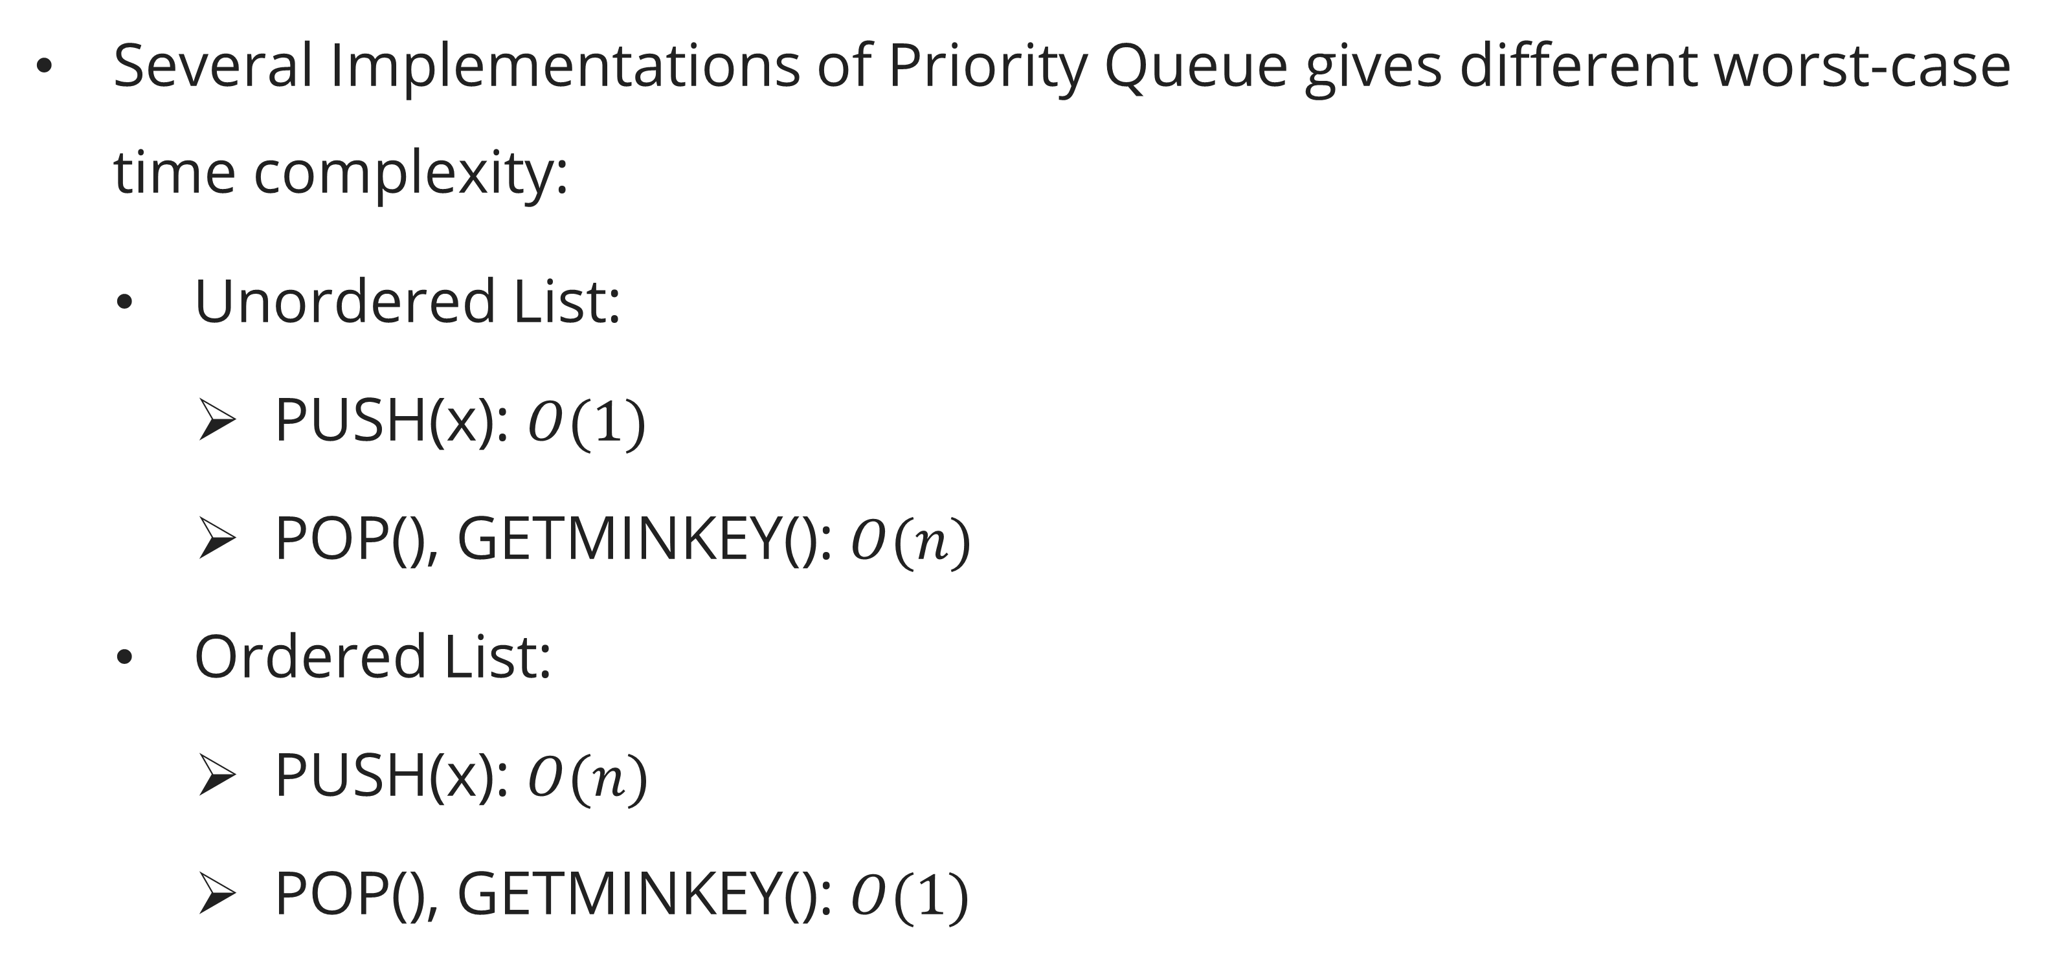
Priority queue
analysis
Several Implementations of Priority Queue gives different worst-case time complexity:
  Unordered List:
    PUSH(x): $O(1)$
    POP(), GETMINKEY(): $O(n)$
  Ordered List:
    PUSH(x): $O(n)$
    POP(), GETMINKEY(): $O(1)$

Slide 47
Priority queue
applications
Job scheduling: always process the highest-priority task next.
Dijkstra's algorithm: always relax the nearest unvisited vertex (Session 20).
Prim's MST: always add the minimum-weight edge to the tree (Session 11).
Huffman coding: always merge the two lowest-frequency trees (Session 12).
Event simulation: always process the earliest event.

Slide 48
Priority queue
heap
Heap
  Is a Complete Binary Tree
  The values ​​at each node is eligible to Minimum Heap or Maximum Heap.

Slide 49
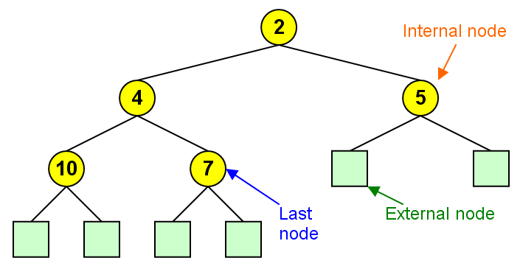
Priority queue
heap

Slide 50
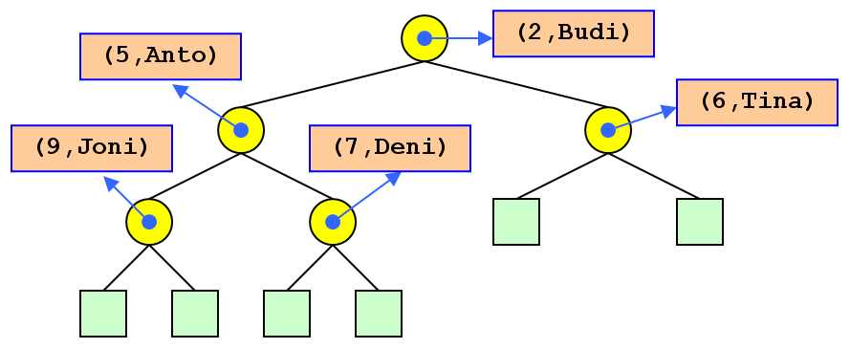
Priority queue
Pq using heap

Slide 51
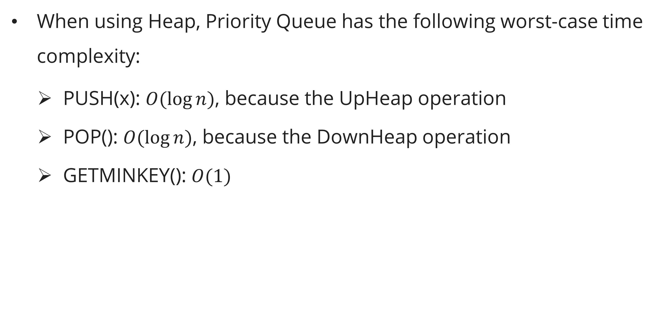
Priority queue
analysis
When using Heap, Priority Queue has the following worst-case time complexity:
  PUSH(x): $O(\log{n})$, because the UpHeap operation
  POP(): $O(\log{n})$, because the DownHeap operation
  GETMINKEY(): $O(1)$

Slide 52
heap
definition
A (max-)heap is a nearly complete binary tree stored as an array A[1..n] satisfying the max-heap property:
A[PARENT(i)] ≥ A[i] for all i > 1.
Equivalently, the key of every node is ≥ the keys of its children. The maximum element is always at A[1].

Slide 53
heap
definition
Array representation (CLRS, p. 161):
PARENT(i) = ⌊i/2⌋
LEFT(i) = 2i
RIGHT(i) = 2i + 1
Example: A = [16, 14, 10, 8, 7, 9, 3, 2, 4, 1]
16
/ \
14 10
/ \ / \
8 7 9 3
/ \ /
2 4 1

Slide 54
heap
MAX-HEAPIFY
Restores the max-heap property at node i, assuming both subtrees are already valid heaps.
Time: O(log n) — the recursion descends at most h = ⌊log₂ n⌋ levels.
MAX-HEAPIFY(A, i, n)
1 l = LEFT(i), r = RIGHT(i)
2 if l ≤ n and A[l] > A[i]: largest = l
3 else: largest = i
4 if r ≤ n and A[r] > A[largest]: largest = r
5 if largest ≠ i
6 swap A[i] and A[largest]
7 MAX-HEAPIFY(A, largest, n)

Slide 55
heap
BUILD-MAX-HEAP
Converts an arbitrary array into a max-heap.
Time: O(n) — although each of the O(n) calls to MAX-HEAPIFY costs O(log n), a tighter analysis shows the total is O(n) because most nodes are near the leaves.
Tight analysis: ∑_{h=0}^{⌊log n⌋} ⌈n/2^(h+1)⌉ · O(h) = O(n · ∑_{h=0}^{∞} h/2^h) = O(n · 2) = O(n).
BUILD-MAX-HEAP(A, n)
1 for i = ⌊n/2⌋ downto 1
2 MAX-HEAPIFY(A, i, n)

Slide 56
heap
Heap Operations
HEAP-EXTRACT-MAX:
Time: O(log n).
HEAP-EXTRACT-MAX(A, n)
1 if n < 1: error "heap underflow"
2 max = A[1]
3 A[1] = A[n]
4 n = n - 1
5 MAX-HEAPIFY(A, 1, n)
6 return max

Slide 57
heap
Heap Operations
MAX-HEAP-INSERT:
HEAP-INCREASE-KEY:
Time: O(log n) — bubbles up at most O(log n) levels.
MAX-HEAP-INSERT(A, key, n)
1 n = n + 1
2 A[n] = -∞
3 HEAP-INCREASE-KEY(A, n, key)
MAX-HEAP-INHEAP-INCREASE-KEY(A, i, key)
1 if key < A[i]: error "new key is smaller"
2 A[i] = key
3 while i > 1 and A[PARENT(i)] < A[i]
4 swap A[i] and A[PARENT(i)]
5 i = PARENT(i)
SERT(A, key, n)
1 n = n + 1
2 A[n] = -∞
3 HEAP-INCREASE-KEY(A, n, key)

Slide 58
heap
DECREASE-KEY for Min-Heap
For algorithms like Dijkstra and Prim, the critical operation is DECREASE-KEY: reduce the key of an existing element and restore the heap property. The following is the min-heap version (CLRS Ch. 6.5, p. 163):
Time: O(log n) — the element moves up at most h = ⌊log₂ n⌋ levels.
MIN-HEAP-DECREASE-KEY(A, i, key)
1 if key > A[i]: error "new key is larger than current key"
2 A[i] = key
3 // Sift up: bubble the decreased key toward the root
4 while i > 1 and A[PARENT(i)] > A[i]
5 swap A[i] and A[PARENT(i)]
6 i = PARENT(i)

Slide 59
heap
DECREASE-KEY for Min-Heap
Why sift up (not down)? Decreasing a key can only violate the min-heap property with the node's parent (the parent may now be larger). Children are unaffected since the node's key got smaller, so the min-heap property with children is still satisfied. We bubble up until the parent is ≤ the new key.
Role in Dijkstra's algorithm: When RELAX(u,v,w) finds a shorter path to v, it calls DECREASE-KEY(Q, v, d[v]) to update v's priority in the min-priority queue. This is why Dijkstra requires O(E log V) time with a binary heap — each of the E relaxations can trigger a DECREASE-KEY costing O(log V).

Slide 60
heap
heapsort
Using a max-heap, we can sort in O(n log n) time and O(1) auxiliary space:
Time: O(n log n). Auxiliary space: O(1) — fully in-place.
HEAPSORT(A, n)
1 BUILD-MAX-HEAP(A, n)
2 for i = n downto 2
3 swap A[1] and A[i]
4 MAX-HEAPIFY(A, 1, i-1)

Slide 61
Space Complexity Comparative Summary
Data Structure | Space | Key Operations
Array | O(n) | Access O(1), search O(n)
Stack (array) | O(n) | Push/Pop O(1)
Queue (circular array) | O(n) | Enqueue/Dequeue O(1)
Linked List | O(n) | Insert/Delete head O(1), search O(n)
BST (balance) | O(n) | Search/Insert/Delete O(log n)
Heap (array) | O(n) | Insert/Extract-max O(log n), Max O(1)
Adjacency matrix | O(V²) | Edge check O(1)
Adjacency list | O(v+E) | Neighbor iteration O(deg)
Hash table | O(n) | Insert/Search/Delete O(1) avg
Key takeaway: The heap gives the best time-space trade-off for priority queue operations — O(n) space and O(log n) per update/extraction.

Slide 62
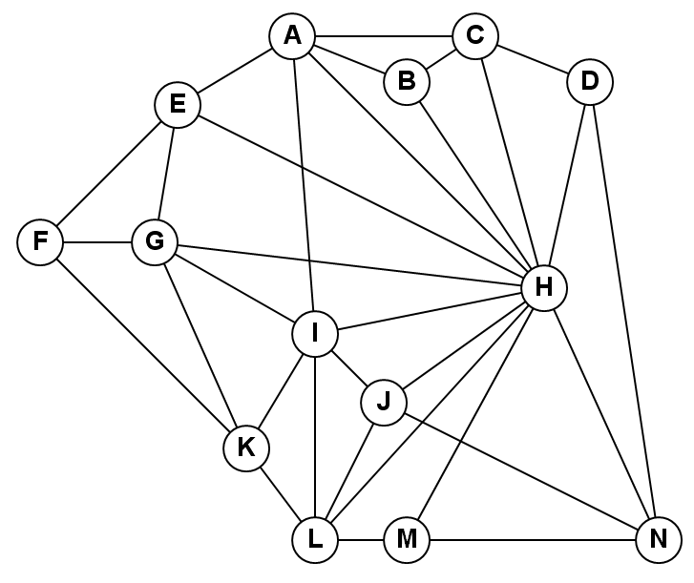
Exercises
Session 6
Suppose that your computer only has enough memory to store 40,000 entries. Which best graph data structure should you use to store a simple undirected graph with 200 vertices, 19,900 edges, and the existence of edge(u,v) is frequently asked?
Do DFS and BFS for the following graph, starting
from A!

Slide 63
References
Session 6
Primary (Required): Cormen, T.H., Leiserson, C.E., Rivest, R.L., & Stein, C. (2022). Introduction to Algorithms, 4th Edition. MIT Press.
Ch. 6.1 — Heaps (p. 161)
Ch. 6.5 — Priority Queues (p. 172)
Ch. 20.1 — Representations of Graphs (p. 549)
Secondary (Required): Skiena, S.S. (2020). The Algorithm Design Manual, 3rd Edition. Springer.
Ch. 7.1 — Flavors of Graphs (p. 198)
Ch. 7.2 — Data Structures for Graphs (p. 203)
Ch. 3.5 — Priority Queues (p. 87)

